Slide 1
Programming With C++/R
DST102TC
Huakang Li
Huakang.li@xjtlu.edu.cn
School of AI and Advanced Computing
Notes:
English Title: Uppercase, Calibri size 60, XJTLU Navy
English Subtitle: Uppercase, Calibri size 36, XJTLU Navy

Slide 2
Chapter 6
Functions
Notes:
English Title: Uppercase, Calibri size 60, XJTLU Navy
English Subtitle: Uppercase, Calibri size 36, XJTLU Navy

Slide 3
Opening Problem
Find the sum of integers from 1 to 10, from 20 to 37, and from 35 to 49, respectively.

Slide 4
Problem
int sum = 0;
for (int i = 1; i <= 10; i++)
sum += i;
cout << "Sum from 1 to 10 is " << sum << endl;
sum = 0;
for (int i = 20; i <= 37; i++)
sum += i;
cout << "Sum from 20 to 37 is " << sum << endl;
sum = 0;
for (int i = 35; i <= 49; i++)
sum += i;
cout << "Sum from 35 to 49 is " << sum << endl;

Slide 5
Problem
int sum = 0;
for (int i = 1; i <= 10; i++)
sum += i;
cout << "Sum from 1 to 10 is " << sum << endl;
sum = 0;
for (int i = 20; i <= 37; i++)
sum += i;
cout << "Sum from 20 to 37 is " << sum << endl;
sum = 0;
for (int i = 35; i <= 49; i++)
sum += i;
cout << "Sum from 35 to 49 is " << sum << endl;

Slide 6
Solution
int sum(int i1, int i2)
{
int sum = 0;
for (int i = i1; i <= i2; i++)
sum += i;
return sum;
}
int main()
{
cout << "Sum from 1 to 10 is " << sum(1, 10) << endl;
cout << "Sum from 20 to 37 is " << sum(20, 37) << endl;
cout << "Sum from 35 to 49 is " << sum(35, 49) << endl;
return 0;
}

Slide 7
Objectives
To define functions with formal parameters (§6.2).
To define/invoke value-returning functions (§6.3).
To define/invoke void functions (§6.4).
To pass arguments by value (§6.5).
To develop reusable code that is modular, easy to read, easy to debug, and easy to maintain (§6.6).
To use function overloading and understand ambiguous overloading (§6.7).
To use function prototypes to declare function headers (§6.8).
To define functions with default arguments (§6.9).
To improve runtime efficiency for short functions using inline functions (§6.10).
To determine the scope of local and global variables (§6.11).
To pass arguments by reference and understand the differences between pass-by-value and pass-by-reference (§6.12).
To declare const parameters to prevent them from being modified accidentally (§6.13).
To write a function that converts a hexadecimal number to a decimal number (§6.14).
To design and implement functions using stepwise refinement (§6.15).

Slide 8
Defining a Function
A function is a collection of statements that are grouped together to perform an operation.

Slide 9
Defining Functions, cont.
Function signature is the combination of the function name and the parameter list.
The variables defined in the function header are known as formal parameters.
When a function is invoked, you pass a value to the parameter. This value is referred to as actual parameter or argument.

Slide 10
Defining Functions, cont.
A Function may return a value. The returnValueType is the data type of the value the function returns. If the function does not return a value, the returnValueType is the keyword void.

Slide 11
Calling a Function
#include <iostream>
using namespace std;
// Return the max between two numbers
int max(int num1, int num2)
{
int result;
if (num1 > num2)
result = num1;
else
result = num2;
return result;
}
int main()
{
int i = 5;
int j = 2;
int k = max(i, j);
cout << "The maximum between " << i <<
" and " << j << " is " << k << endl;
return 0;
}
Testing the max Function

Slide 12
Calling Functions, cont.

Slide 13
Trace Function Invocation
i is now 5

Slide 14
Trace Function Invocation
j is now 2

Slide 15
Trace Function Invocation
invoke max(i, j)

Slide 16
Trace Function Invocation
invoke max(i, j)
Pass the value of i to num1
Pass the value of j to num2

Slide 17
Trace Function Invocation
declare variable result

Slide 18
Trace Function Invocation
(num1 > num2) is true since num1 is 5 and num2 is 2

Slide 19
Trace Function Invocation
result is now 5

Slide 20
Trace Function Invocation
return result, which is 5

Slide 21
Trace Function Invocation
return max(i, j) and assign the return value to k

Slide 22
Trace Function Invocation
Execute the print statement

Slide 23
Call Stacks

Slide 24
Trace Call Stack
i is declared and initialized

Slide 25
Trace Call Stack
j is declared and initialized

Slide 26
Trace Call Stack
Declare k

Slide 27
Trace Call Stack
Invoke max(i, j)

Slide 28
Trace Call Stack
pass the values of i and j to num1 and num2

Slide 29
Trace Call Stack
(num1 > num2) is true

Slide 30
Trace Call Stack
Assign num1 to result

Slide 31
Trace Call Stack
Return result and assign it to k

Slide 32
Trace Call Stack
Execute print statement

Slide 33
void Functions
The preceding section gives an example of a nonvoid function.
This section shows how to declare and invoke a void function.
Listing 6.2 gives a program that declares a function named printGrade and invokes it to print the grade for a given score.

Slide 34

TestVoidFunction.cpp
#include <iostream>
using namespace std;
// Print grade for the score
void printGrade(double score)
{
if (score >= 90.0)
cout << 'A' << endl;
else if (score >= 80.0)
cout << 'B' << endl;
else if (score >= 70.0)
cout << 'C' << endl;
else if (score >= 60.0)
cout << 'D' << endl;
else
cout << 'F' << endl;
}
int main()
{
cout << "Enter a score: ";
double score;
cin >> score;
cout << "The grade is ";
printGrade(score);
return 0;
}

Slide 35

TestReturnGradeFunction.cpp
#include <iostream>
using namespace std;
// Return the grade for the score
char getGrade(double score)
{
if (score >= 90.0)
return 'A';
else if (score >= 80.0)
return 'B';
else if (score >= 70.0)
return 'C';
else if (score >= 60.0)
return 'D';
else
return 'F';
}
int main()
{
cout << "Enter a score: ";
double score;
cin >> score;
cout << "The grade is ";
cout << getGrade(score) << endl;
return 0;
}

Slide 36
Passing Arguments by Value
By default, the arguments are passed by value to parameters when invoking a function.
The power of a function is its ability to work with parameters.
You can use max to find the maximum between any two int values.
When calling a function, you need to provide arguments, which must be given in the same order as their respective parameters in the function signature.
This is known as parameter order association. For example, the following function prints a character n times.

Slide 37
Modularizing Code
Methods can be used to reduce redundant coding and enable code reuse.
Methods can also be used to modularize code and improve the quality of the program.

Slide 38
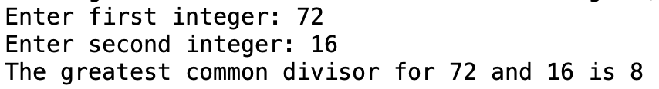
GreatestCommonDivisorFunction.cpp
int main(){
// Prompt the user to enter two integers
cout << "Enter first integer: ";
int n1;
cin >> n1;
cout << "Enter second integer: ";
int n2;
cin >> n2;
cout << "The greatest common divisor for " << n1 <<
" and " << n2 << " is " << gcd(n1, n2) << endl;
return 0;
}
#include <iostream>
using namespace std;
// Return the gcd of two integers
int gcd(int n1, int n2){
int gcd = 1; // Initial gcd is 1
int k = 2; // Possible gcd
while (k <= n1 && k <= n2)
{ if (n1 % k == 0 && n2 % k == 0)
gcd = k; // Update gcd
k++;
}
return gcd; // Return gcd
}

Slide 39
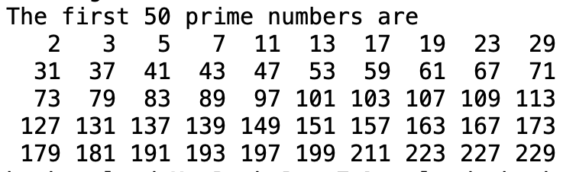
PrimeNumberFunction.cpp
// Repeatedly find prime numbers
while (count < numberOfPrimes)
{
// Print the prime number and increase the count
if (isPrime(number))
{
count++; // Increase the count
if (count % NUMBER_OF_PRIMES_PER_LINE == 0)
{
// Print the number and advance to the new line
cout << setw(4) << number << endl;
}
else
cout << setw(4) << number;
}
// Check if the next number is prime
number++;
}
}
int main()
{
cout << "The first 50 prime numbers are \n";
printPrimeNumbers(50);
return 0;
}
#include <iostream>
#include <iomanip>
using namespace std;
// Check whether number is prime
bool isPrime(int number)
{
for (int divisor = 2; divisor <= number / 2; divisor++)
{
if (number % divisor == 0)
{
// If true, number is not prime
return false; // number is not a prime
}
}
return true; // number is prime
}
void printPrimeNumbers(int numberOfPrimes)
{
const int NUMBER_OF_PRIMES_PER_LINE = 10; // Display 10 per line
int count = 0; // Count the number of prime numbers
int number = 2; // A number to be tested for primeness

Slide 40
Overloading Functions
The max function that was used earlier works only with the int data type.
But what if you need to find which of two floating-point numbers has the maximum value?
The solution is to create another function with the same name but different parameters, as shown in the following code:

Slide 41
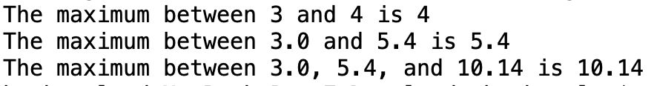
TestFunctionOverloading.cpp
#include <iostream>
using namespace std;
// Return the max between two int values
int max(int num1, int num2){
if (num1 > num2)
return num1;
else
return num2;}
// Find the max between two double values
double max(double num1, double num2){
if (num1 > num2)
return num1;
else
return num2;}
// Return the max among three double values
double max(double num1, double num2, double num3){
return max(max(num1, num2), num3);}
int main()
{
// Invoke the max function with int parameters
cout << "The maximum between 3 and 4 is " << max(3, 4) << endl;
// Invoke the max function with the double parameters
cout << "The maximum between 3.0 and 5.4 is "
<< max(3.0, 5.4) << endl;
// Invoke the max function with three double parameters
cout << "The maximum between 3.0, 5.4, and 10.14 is "
<< max(3.0, 5.4, 10.14) << endl;
return 0;
}

Slide 42
Ambiguous Invocation
Sometimes there may be two or more possible matches for an invocation of a function, but the compiler cannot determine the most specific match.
This is referred to as ambiguous invocation. Ambiguous invocation is a compilation error.

Slide 43
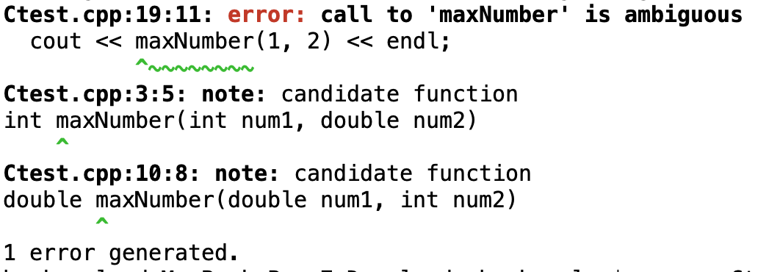
Ambiguous Invocation
#include <iostream>
using namespace std;
int maxNumber(int num1, double num2)
{
if (num1 > num2)
return num1;
else
return num2;
}
double maxNumber(double num1, int num2)
{
if (num1 > num2)
return num1;
else
return num2;
}
int main()
{
cout << maxNumber(1, 2) << endl;
return 0;
}

Slide 44
Function Prototypes
Before a function is called, it must be declared first. One way to ensure it is to place the declaration before all function calls.
Another way to approach it is to declare a function prototype before the function is called.
A function prototype is a function declaration without implementation.
The implementation can be given later in the program.

Slide 45
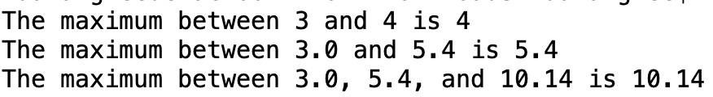
TestFunctionPrototype.cpp
// Return the max between two int values
int max(int num1, int num2)
{
if (num1 > num2)
return num1;
else
return num2;
}
// Find the max between two double values
double max(double num1, double num2){
if (num1 > num2)
return num1;
else
return num2;
}
// Return the max among three double values
double max(double num1, double num2, double num3)
{
return max(max(num1, num2), num3);
}
#include <iostream>
using namespace std;
// Function prototype
int max(int num1, int num2);
double max(double num1, double num2);
double max(double num1, double num2, double num3);
int main(){
// Invoke the max function with int parameters
cout << "The maximum between 3 and 4 is " <<
max(3, 4) << endl;
// Invoke the max function with the double parameters
cout << "The maximum between 3.0 and 5.4 is "
<< max(3.0, 5.4) << endl;
// Invoke the max function with three double parameters
cout << "The maximum between 3.0, 5.4, and 10.14 is "
<< max(3.0, 5.4, 10.14) << endl;
return 0;
}

Slide 46

Default Arguments
C++ allows you to declare functions with default argument values. The default values are passed to the parameters when a function is invoked without the arguments.
#include <iostream>
using namespace std;
// Display area of a circle
void printArea(double radius = 1)
{
double area = radius * radius * 3.14159;
cout << "area is " << area << endl;
}
int main()
{
printArea();
printArea(4);
return 0;
}

Slide 47
Inline Functions
Implementing a program using functions makes the program easy to read and easy to maintain, but function calls involve runtime overhead (i.e., pushing arguments and CPU registers into the stack and transferring control to and from a function).
C++ provides inline functions to avoid function calls.
Inline functions are not called; rather, the compiler copies the function code in line at the point of each invocation.
To specify an inline function, precede the function declaration with the inline keyword, as shown in Listing 6.18.

Slide 48
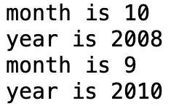
InlineDemo.cpp
#include <iostream>
using namespace std;
inline void f(int month, int year)
{
cout << "month is " << month << endl;
cout << "year is " << year << endl;
}
int main()
{
int month = 10, year = 2008;
f(month, year); // Invoke inline function
f(9, 2010); // Invoke inline function
return 0;
}
#include <iostream>
using namespace std;
int main()
{
int month = 10, year = 2008;
cout << "month is " << month << endl;
cout << "year is " << year << endl;
cout << "month is " << 9 << endl;
cout << "year is " << 2010 << endl;
return 0;
}

Slide 49
Short Functions Not for long Functions Compiler Decision
Inline functions are desirable for short functions, but not suitable for long functions that are called in multiple places in a program, because long inline functions will dramatically increase the executable code size when it is copied in multiple places.
For this reason, C++ allows the compilers to ignore the inline keyword if the function is too long.
So, the inline keyword is merely a request to the compiler, and it is up for the compiler to make the decision whether to honor it or ignore it.

Slide 50
Scope of Variables
A local variable: a variable defined inside a function.
Scope: the part of the program where the variable can be referenced.
The scope of a variable starts from its declaration and continues to the end of the block that contains the variable.

Slide 51
Scope of Local Variables, cont.
You can declare a local variable with the same name in different blocks.

Slide 52
Scope of Local Variables, cont.
A variable declared in the initial action part of a for loop header has its scope in the entire loop. But a variable declared inside a for loop body has its scope limited in the loop body from its declaration and to the end of the block that contains the variable.

Slide 53
Scope of Local Variables, cont.

Slide 54
Global Variables
C++ also allows you to use global variables.
They are declared outside all functions and are accessible to all functions in its scope.
Local variables do not have default values, but global variables are defaulted to zero.

Slide 55
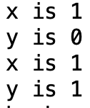
VariableScopeDemo.cpp
int y; // Global variable, default to 0
void t1()
{
int x = 1;
cout << "x is " << x << endl;
cout << "y is " << y << endl;
x++;
y++;
}
void t2()
{
int x = 1;
cout << "x is " << x << endl;
cout << "y is " << y << endl;
}
#include <iostream>
using namespace std;
void t1(); // Function prototype
void t2(); // Function prototype
int main()
{
t1();
t2();
return 0;
}

Slide 56

Unary Scope Resolution
If a local variable name is the same as a global variable name, you can access the global variable using ::globalVariable. The :: operator is known as the unary scope resolution. For example, the following code:
#include <iostream>
using namespace std;
int v1 = 10;
int main()
{
int v1 = 5;
cout << "local variable v1 is " << v1 << endl;
cout << "global variable v1 is " << ::v1 << endl;
return 0;
}

Slide 57
Static Local Variables
After a function completes its execution, all its local variables are destroyed.
Sometimes, it is desirable to retain the value stored in local variables so that they can be used in the next call.
C++ allows you to declare static local variables.
Static local variables are permanently allocated in the memory for the lifetime of the program.
To declare a static variable, use the keyword static.

Slide 58
#include <iostream>
using namespace std;
void t1(); // Function prototype
int main()
{
t1();
t1();
return 0;
}
void t1()
{
static int x = 1;
int y = 1;
x++;
y++;
cout << "x is " << x << endl;
cout << "y is " << y << endl;
}
StaticVariableDemo.cpp
x is 2
y is 2
x is 3
y is 2

Slide 59
Pass by Value
When you invoke a function with a parameter, the value of the argument is passed to the parameter.
This is referred to as pass-by-value. If the argument is a variable rather than a literal value, the value of the variable is passed to the parameter.
The variable is not affected, regardless of the changes made to the parameter inside the function.

Slide 60
Increment.cpp
#include <iostream>
using namespace std;
void increment(int n)
{
n++;
cout << "\tn inside the function is " << n << endl;
}
int main()
{
int x = 1;
cout << "Before the call, x is " << x << endl;
increment(x);
cout << "after the call, x is " << x << endl;
return 0;
}
Before the call, x is 1
n inside the function is 2
after the call, x is 1

Slide 61
Pass by Value, cont.
Pass-by-value has serious limitations. Listing 6.2 gives a program that shows the effect and limitation of passing by value. The program creates a function for swapping two variables. The swap function is invoked by passing two arguments. Interestingly, the values of the arguments are not changed after the function is invoked.

Slide 62
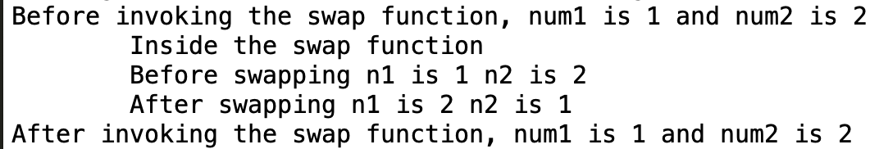
SwapByValue.cpp
int main()
{
// Declare and initialize variables
int num1 = 1;
int num2 = 2;
cout << "Before invoking the swap function, num1 is "
<< num1 << " and num2 is " << num2 << endl;
// Invoke the swap function to attempt to swap two variables
swap(num1, num2);
cout << "After invoking the swap function, num1 is " << num1 <<
" and num2 is " << num2 << endl;
return 0;
}
#include <iostream>
using namespace std;
// Attempt to swap two variables does not work!
void swap(int n1, int n2)
{
cout << "\tInside the swap function" << endl;
cout << "\tBefore swapping n1 is " << n1 <<
" n2 is " << n2 << endl;
// Swap n1 with n2
int temp = n1;
n1 = n2;
n2 = temp;
cout << "\tAfter swapping n1 is " << n1 <<
" n2 is " << n2 << endl;
}

Slide 63
Pass by Value, cont.

Slide 64
Pass by Reference, cont.

Slide 65
Reference Variables
C++ provides a special type of variable, called a reference variable, which can be used as a function parameter to reference the original variable.
A reference variable is an alias for another variable. Any changes made through the reference variable are actually performed on the original variable.
To declare a reference variable, place the ampersand (&) in front of the name. For example, see Listing 6.4.

Slide 66
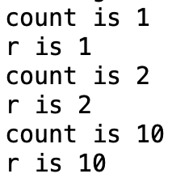
TestReferenceVariable.cpp
#include <iostream>
using namespace std;
int main()
{
int count = 1;
int& r = count;
cout << "count is " << count << endl;
cout << "r is " << r << endl;
r++;
cout << "count is " << count << endl;
cout << "r is " << r << endl;
count = 10;
cout << "count is " << count << endl;
cout << "r is " << r << endl;
return 0;
}

Slide 67
Pass By Reference
You can use a reference variable as a parameter in a function and pass a regular variable to invoke the function. The parameter becomes an alias for the original variable. This is known as pass-by-reference. When you change the value through the reference variable, the original value is actually changed.

Slide 68
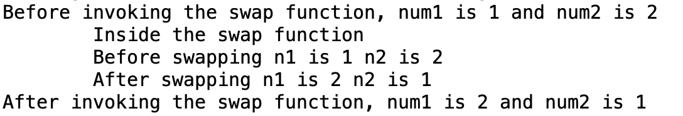
int main()
{
// Declare and initialize variables
int num1 = 1;
int num2 = 2;
cout << "Before invoking the swap function, num1 is "
<< num1 << " and num2 is " << num2 << endl;
// Invoke the swap function to attempt to swap two variables
swap(num1, num2);
cout << "After invoking the swap function, num1 is " << num1 <<
" and num2 is " << num2 << endl;
return 0;
}
SwapByReference.cpp
#include <iostream>
using namespace std;
// Swap two variables
void swap(int& n1, int& n2)
{
cout << "\tInside the swap function" << endl;
cout << "\tBefore swapping n1 is " << n1 <<
" n2 is " << n2 << endl;
// Swap n1 with n2
int temp = n1;
n1 = n2;
n2 = temp;
cout << "\tAfter swapping n1 is " << n1 <<
" n2 is " << n2 << endl;
}

Slide 69
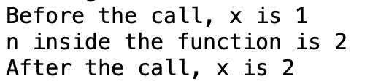
IncrementWithPassByReference.cpp
#include <iostream>
using namespace std;
void increment(int& n)
{
n++;
cout << "n inside the function is " << n << endl;
}
int main()
{
int x = 1;
cout << "Before the call, x is " << x << endl;
increment(x);
cout << "After the call, x is " << x << endl;
return 0;
}

Slide 70
Constant Reference Parameters
// Return the max between two numbers
int max(const int& num1, const int& num2)
{
int result;
if (num1 > num2)
result = num1;
else
result = num2;
return result;
}

Slide 71
Pass-by-Value or Pass-by-Reference
In pass-by-value, the actual parameter and its formal parameter are independent variables.
In pass-by-reference, the actual parameter and its formal parameter refer to the same variable. Pass-by-reference is more efficient than pass-by-value.
However, the difference is negligible for parameters of primitive types such as int and double.
So, if a primitive data type parameter is not changed in the function, you should declare it as pass-by-value parameter.

Slide 72
Case Study: Converting Hexadecimals to Decimals
Write a function that converts a hexadecimal number into a decimal number.
ABCD =>
A*16^3 + B*16^2 + C*16^1+ D*16^0
= ((A*16 + B)*16 + C)*16+D

Slide 73
Hex2Dec.cpp
int hex2Dec(const string& hex)
{
int decimalValue = 0;
for (unsigned i = 0; i < hex.size(); i++)
decimalValue = decimalValue * 16 + hexCharToDecimal(hex[i]);
return decimalValue;
}
int hexCharToDecimal(char ch)
{
ch = toupper(ch); // Change it to uppercase
if (ch >= 'A' && ch <= 'F')
return 10 + ch - 'A';
else // ch is '0', '1', ..., or '9'
return ch - '0';
}
#include <iostream>
#include <string>
#include <cctype>
using namespace std;
// Converts a hex number as a string to decimal
int hex2Dec(const string& hex);
// Converts a hex character to a decimal value
int hexCharToDecimal(char ch);
int main()
{
// Prompt the user to enter a hex number as a string
cout << "Enter a hex number: ";
string hex;
cin >> hex;
cout << "The decimal value for hex number " << hex
<< " is " << hex2Dec(hex) << endl;
return 0;
}

Slide 74
Function Abstraction
You can think of the function body as a black box that contains the detailed implementation for the function.

Slide 75
Benefits of Functions
Write a function once and reuse it anywhere.
Information hiding. Hide the implementation from the user.
Reduce complexity.

Slide 76
Stepwise Refinement
The concept of Function abstraction can be applied to the process of developing programs. When writing a large program, you can use the “divide and conquer” strategy, also known as stepwise refinement, to decompose it into subproblems.
The subproblems can be further decomposed into smaller, more manageable problems.

Slide 77
PrintCalendar.cpp
#include <iostream>
#include <iomanip>
using namespace std;
// Function prototypes
void printMonth(int year, int month);
void printMonthTitle(int year, int month);
void printMonthName(int month);
void printMonthBody(int year, int month);
int getStartDay(int year, int month);
int getTotalNumberOfDays(int year, int month);
int getNumberOfDaysInMonth(int year, int month);
bool isLeapYear(int year);
int main(){
// Prompt the user to enter year
cout << "Enter full year (e.g., 2001): ";
int year;
cin >> year;
// Prompt the user to enter month
cout << "Enter month in number between 1 and 12: ";
int month;
cin >> month;
// Print calendar for the month of the year
printMonth(year, month);
return 0;}

Slide 78
PrintCalender Case Study
Let us use the PrintCalendar example to demonstrate the stepwise refinement approach.

Slide 79
Design Diagram

Slide 80
Implementation: Top-Down
Top-down approach is to implement one Function in the structure chart at a time from the top to the bottom. Stubs can be used for the Functions waiting to be implemented. A stub is a simple but incomplete version of a Function. The use of stubs enables you to test invoking the Function from a caller. Implement the main Function first and then use a stub for the printMonth Function. For example, let printMonth display the year and the month in the stub. Thus, your program may begin like this:

Slide 81
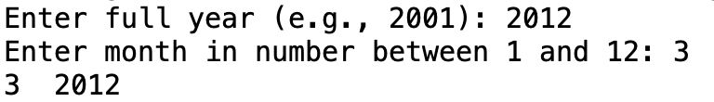
int main()
{
// Prompt the user to enter year
cout << "Enter full year (e.g., 2001): ";
int year;
cin >> year;
// Prompt the user to enter month
cout << "Enter month in number between 1 and 12: ";
int month;
cin >> month;
// Print calendar for the month of the year
printMonth(year, month);
return 0;
}
void printMonth(int year, int month)
{
cout << month << " " << year << endl;
}
PrintCalendarSkeleton.cpp
#include <iostream>
#include <iomanip>
using namespace std;
void printMonth(int year, int month);
void printMonthTitle(int year, int month);
void printMonthName(int month);
void printMonthBody(int year, int month);
int getStartDay(int year, int month);
int getTotalNumberOfDays(int year, int month);
int getNumberOfDaysInMonth(int year, int month);
bool isLeapYear(int year);

Slide 82
Implementation: Bottom-Up
Bottom-up approach is to implement one Function in the structure chart at a time from the bottom to the top.
For each Function implemented, write a test program to test it.
Both top-down and bottom-up Functions are fine.
Both approaches implement the Functions incrementally and help to isolate programming errors and makes debugging easy. Sometimes, they can be used together.

Slide 83
Benefits of Stepwise Refinement
Simpler Program
Reusing Functions
Easier Developing, Debugging, and Testing
Better Facilitating Teamwork

Slide 84
summarization
Fucntion Defining
Function Calling
Tracking Function
Void Function
Overloading
Function Prototypes
Global Variables

Slide 85



THANK YOU
Visit us
FOLLOW us
www.xjtlu.edu.cn
Notes:
Title: Uppercase, Calibri size 60, XJTLU Navy

